Slide 1
IBM University Engagement Project Submission
“Exploring the Power of Agentic AI with IBM Granite and IBM Bob”

Slide 2

Project Tile – [Problem Statement No.6 – Eco Lifestyle Agent ]
Domain of Project – [ life ]
Student Name | Recent Passport Photo | Email ID | Mobile number [WhatsApp]
TEJAS TIWARI |  | tejastiwari.610@gmail.com | 9599317991

Slide 3
Problem Statement -
Problem Statement : Eco Lifestyle Agent
The Challenge An Eco Lifestyle Agent, powered by RAG (Retrieval-Augmented Generation), empowers users to adopt a greener lifestyle through personalized, practical suggestions. It retrieves sustainable living tips, eco-friendly product recommendations, local recycling guidelines, and government schemes from trusted environmental sources.
The Objective
Users can ask natural language questions such as “How can I reduce plastic use at home?” or “What are eco-friendly travel options in my city?” and receive instant, actionable guidance. The agent promotes small daily actions with big environmental impact, making sustainability easy and accessible. This AI-driven assistant fosters eco-conscious decisions, raises awareness, and helps build a more sustainable future.

Slide 4
Proposed Solution -
Proposed Solution: AI-Powered Nutrition Agent
The proposed solution is a multi-agent AI-powered Nutrition Agent built using IBM Bob, IBM watsonx.ai, and Granite Models to provide personalized, real-time dietary guidance. The system addresses challenges in diet planning, nutrition tracking, and preventive healthcare through an intelligent, modular architecture.
At its core, the solution uses a Retrieval-Augmented Generation (RAG) pipeline to fetch accurate nutritional data from trusted sources such as USDA and WHO datasets. This data is embedded and stored in a vector database, enabling the system to retrieve and summarize food nutrition details (calories, macros, vitamins) using Granite models.
The system consists of four key agents:
Nutrition Knowledge Agent retrieves and summarizes nutritional information using RAG.
Diet Recommendation Agent generates personalized meal plans based on user inputs such as age, health conditions, dietary preferences, and fitness goals.
Health Advisory Agent provides preventive health suggestions, including disease-specific diets (e.g., diabetes-friendly or heart-healthy plans).
Food Log & Feedback Agent allows users to log meals via text, voice, or images and delivers instant nutritional analysis with actionable feedback.
The solution includes a user-friendly dashboard (built with Streamlit or React) that visualizes daily and weekly nutrient intake, highlights deficiencies, and tracks progress toward health goals.
IBM Bob is used to orchestrate agent workflows, while watsonx.ai ensures scalable model deployment, embeddings, and AI governance. Granite models power reasoning, summarization, and personalization.
Overall, this solution delivers an end-to-end intelligent nutrition assistant that promotes healthier lifestyles through personalized insights, real-time feedback, and preventive healthcare recommendations.

Slide 5
Technology Used
IBM Bob platform -For designing and orchestrating multi-agent workflows visually
IBM Grainte model - for eg – ibm-granite-3-2-8b – For natural language understanding, reasoning, and personalization
IBM Cloud – It provides the infrastructure to build, deploy, and scale the Nutrition Agent efficiently. IBM Cloud enables a reliable, secure, and scalable environment for deploying the Nutrition Agent.
RAG– RAG to fetch real data first, then generate intelligent answers, making the Nutrition Agent more trustworthy and effective.
IBM Watsonx.ai - For model deployment, embeddings, and AI governance
Vector Database (FAISS/Chroma) – For RAG-based nutritional data retrieval

Slide 6
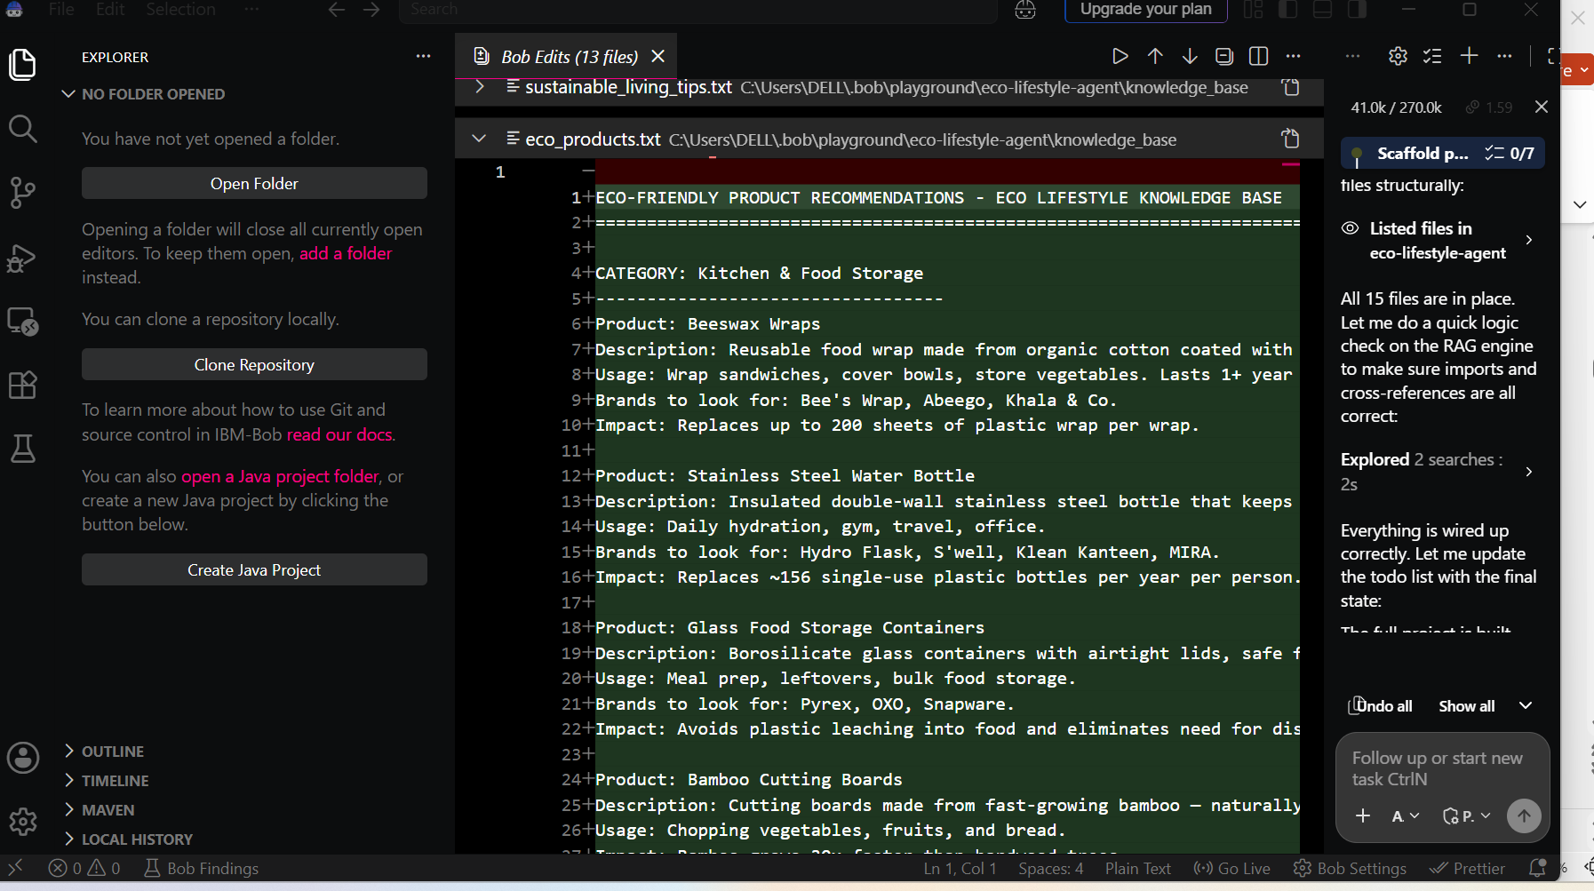
Required Files created using IBM bob -
App.py
Requirements.txt
Style.css
.env
Index.html

Slide 7
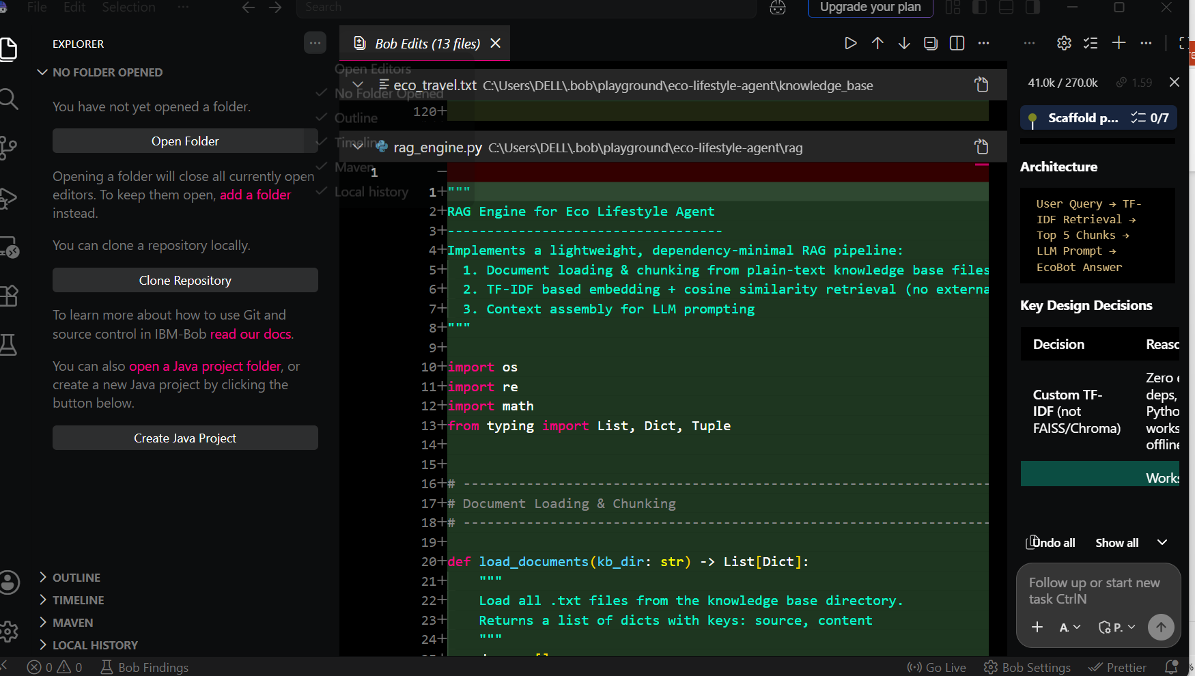
IBM Bob Screenshots:

Slide 8
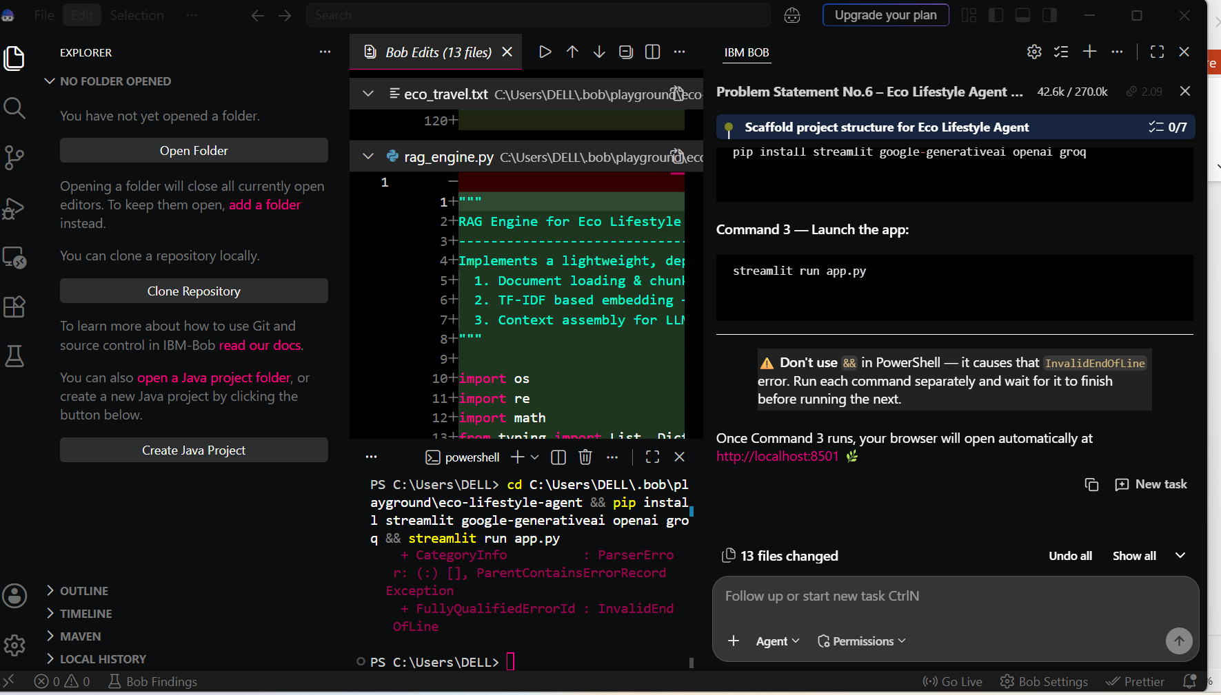

Slide 9
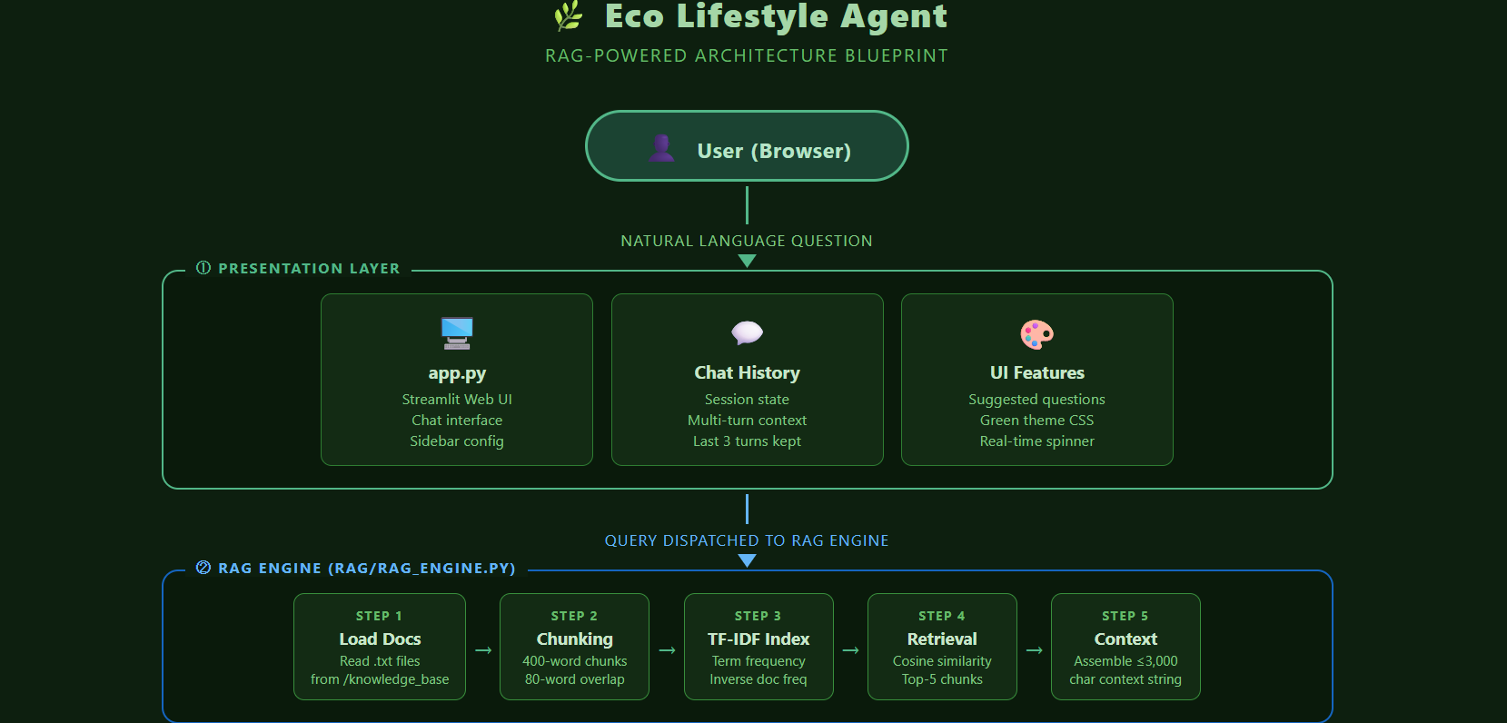
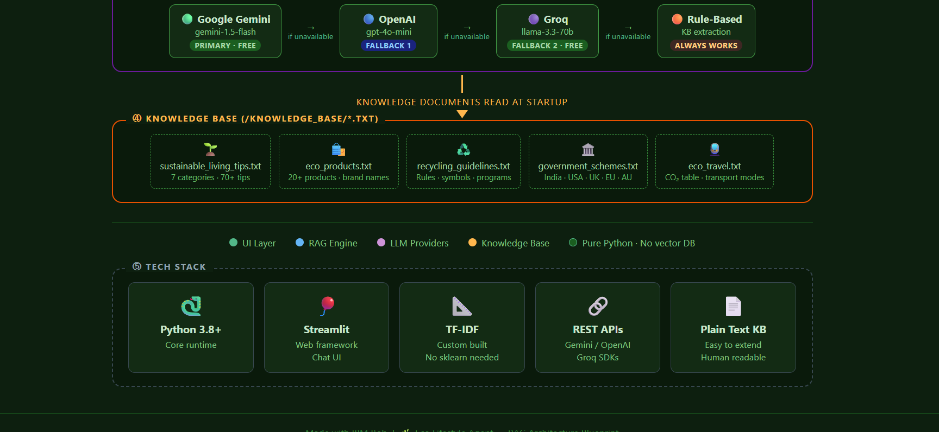
Architecture blueprint for IBM bob:

Slide 10

Role of Agentic AI in the solution
The Eco Lifestyle Agent demonstrates agentic AI through its ability to autonomously perceive, reason, retrieve, and respond — going far beyond a simple question-answer chatbot.
1. Autonomous Goal-Directed Behavior The agent independently decides what to retrieve, how much context to gather, and which LLM to use — without human intervention at each step. Given a query, it self-directs the entire pipeline from retrieval to response generation.
2. Perception & Understanding It interprets natural language queries — understanding intent behind phrases like "What can I do today to be greener?" — rather than relying on rigid keyword matching. This is a hallmark of agentic cognition.
3. Tool Use (RAG as a Tool) The agent actively uses a tool — the TF-IDF retrieval engine — to fetch relevant knowledge before answering. This mirrors how agentic AI systems use external tools to augment their own knowledge, preventing hallucination.
4. Multi-Step Reasoning It chains multiple steps autonomously: tokenize query → compute similarity → retrieve chunks → assemble context → construct prompt → call LLM → return answer. Each step feeds the next with no human in the loop.
5. Adaptive Fallback Decision-Making When one LLM is unavailable, the agent decides to try the next provider — Gemini → OpenAI → Groq → Rule-based. This self-correcting behavior is a core agentic trait: resilience through autonomous decision trees.
6. Memory-Aware Conversation It maintains conversational context across turns, enabling multi-round reasoning — another pillar of agentic AI design.

Slide 11
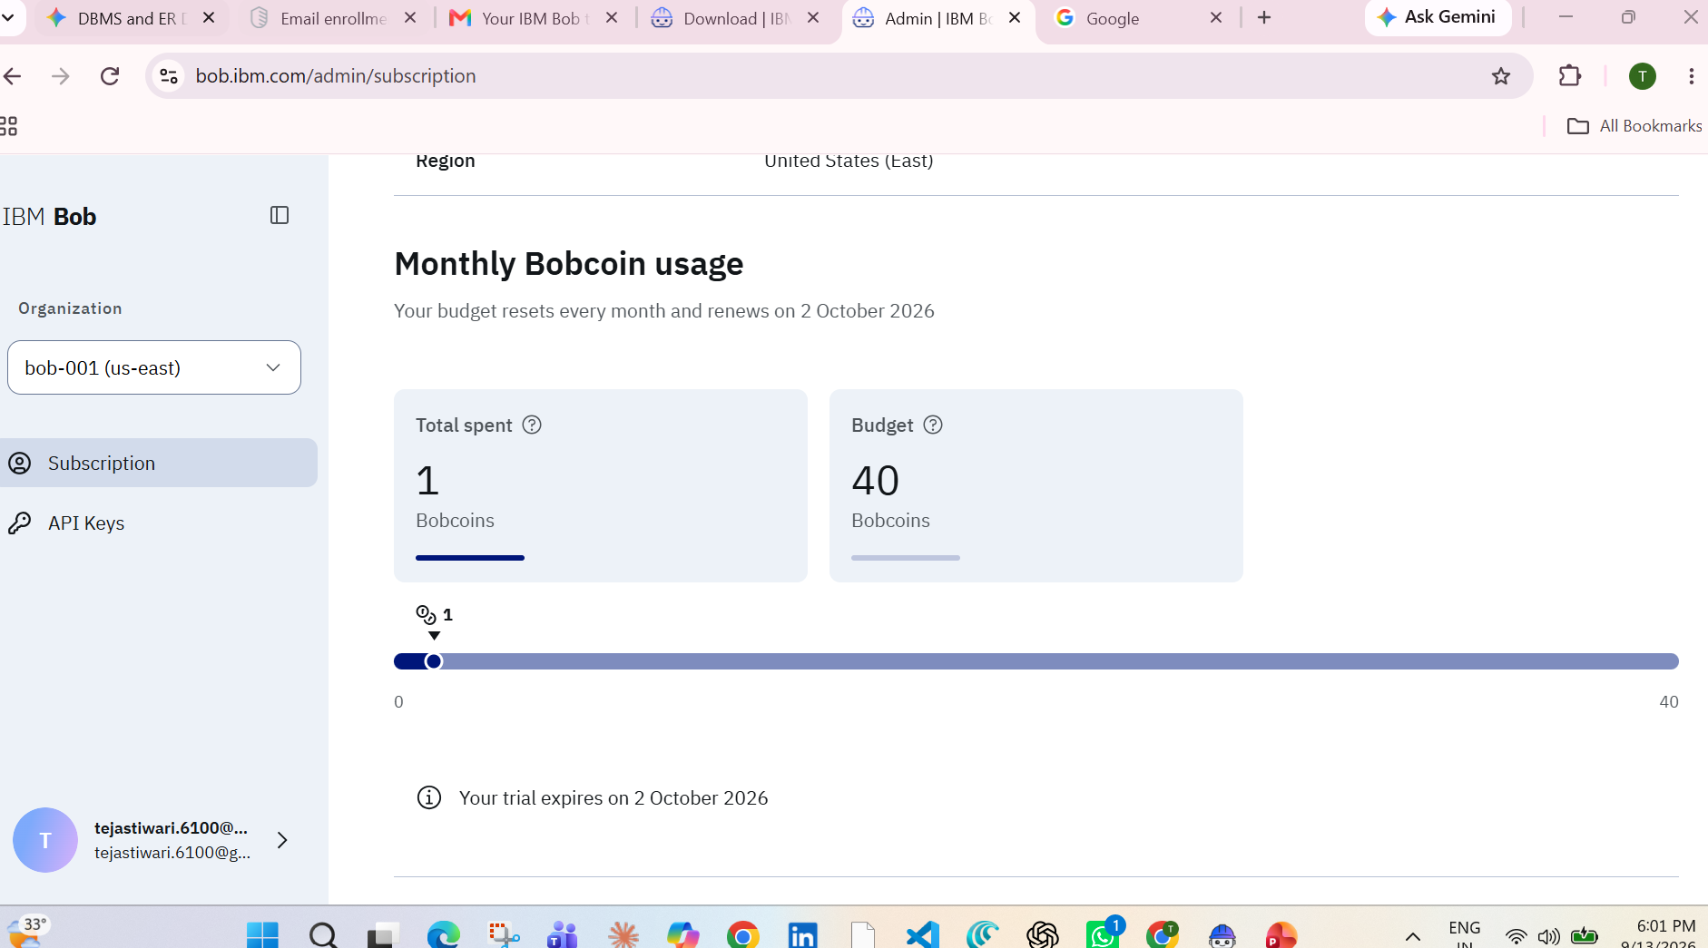
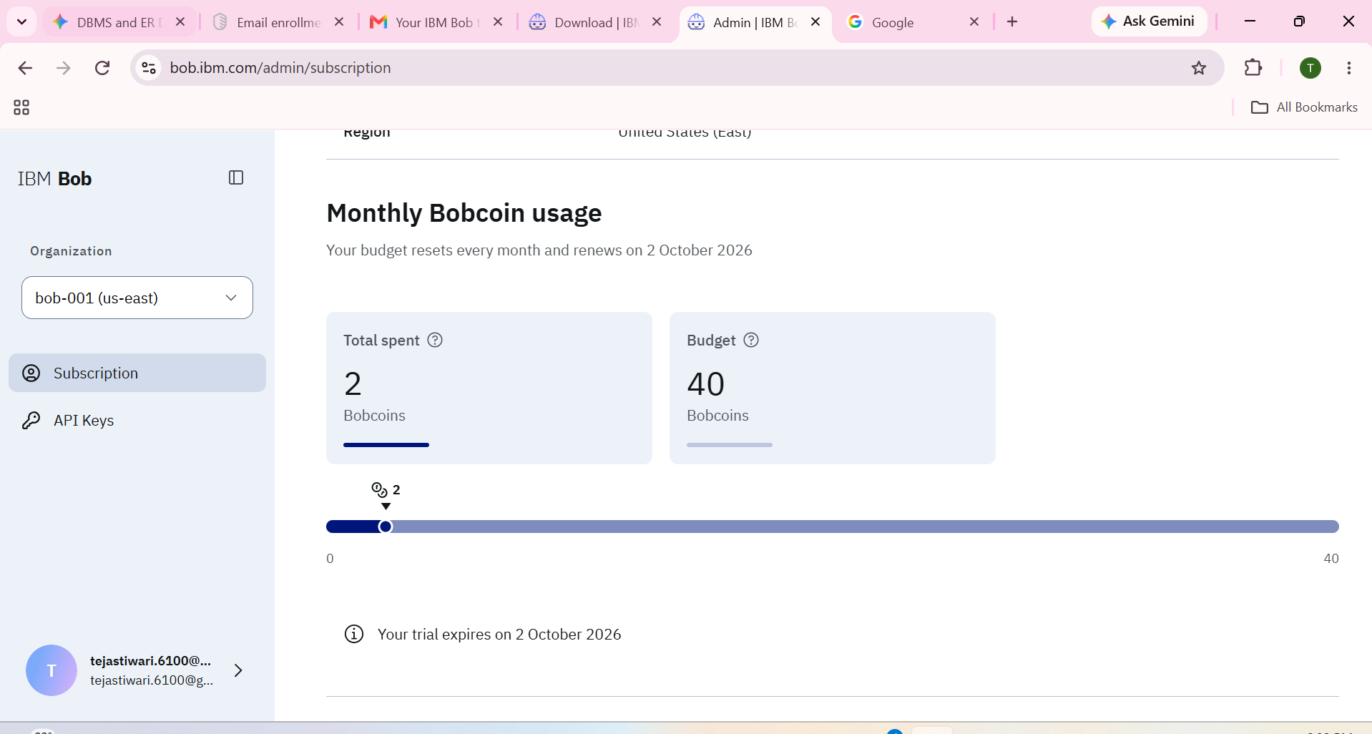
Token Usage
11,761 token are used
Before Prompt
After the Prompt
·
·
·

Slide 12
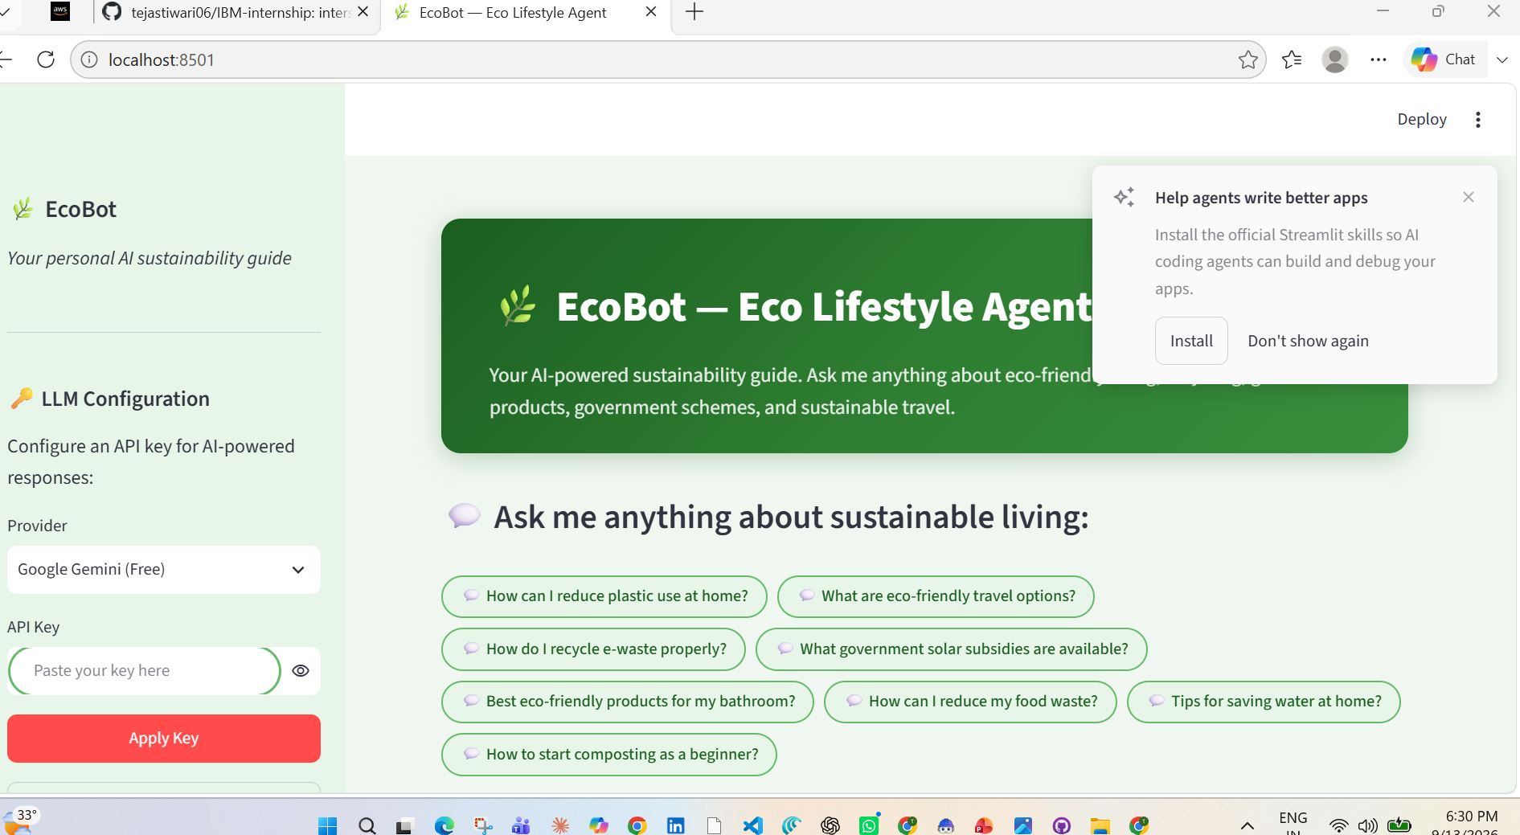
Project Output Screenshot
Please put IBM Bob output screenshots with 2-3 prompts.
You can take 2-3 more slides for each screenshot
·
·
·

Slide 13
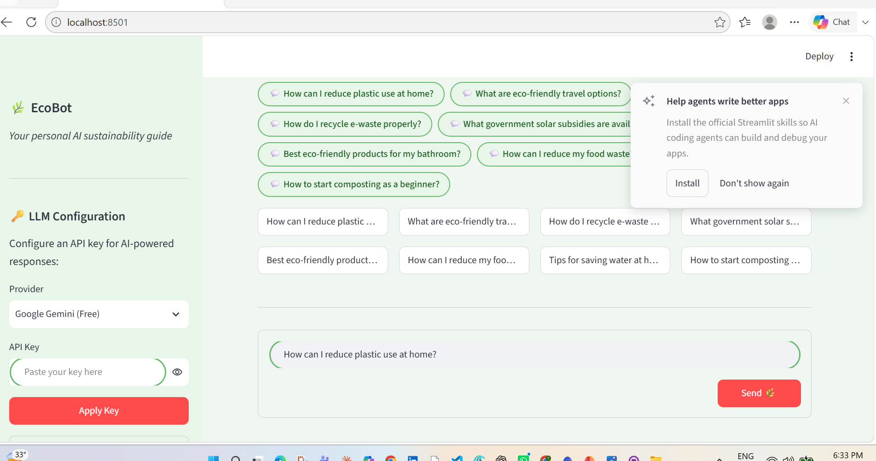
Project Output Screenshot
Please put IBM Bob output screenshots with 2-3 prompts.
You can take 2-3 more slides for each screenshot
·
·
·

Slide 14
Novelty and Uniqueness
Zero-Dependency RAG | Built TF-IDF retrieval from scratch — no FAISS, no ChromaDB, no Pinecone. Runs on any laptop with just Python
Always Works | Gemini → OpenAI → Groq → Rule-based fallback chain means it never breaks, even without internet
Real Government Data | Actual schemes with application steps — PM Surya Ghar, FAME India, US Inflation Reduction Act, UK Boiler Upgrade Scheme
What Makes It Novel (Top 3)

Slide 15
Git Hub Link
https://github.com/tejastiwari06/IBM-internship.git
·
·
·

Slide 16
Future Scope
1.Integration with Wearables & Health Devices –
.
Phase | Feature
Phase 1 | 📸 Image recognition for waste sorting · 🗺️ Location-aware local schemes
Phase 2 | 📊 Personal carbon footprint tracker · 🏆 Gamification & eco challenges
Phase 3 | 🛒 Smart eco shopping assistant · 🌐 Real-time KB auto-updates
Phase 4 | 📱 Mobile app + voice interface · 🏙️ Municipal/Enterprise white-labeling
·
Future Scope — 4 Phases
·
·

Slide 17
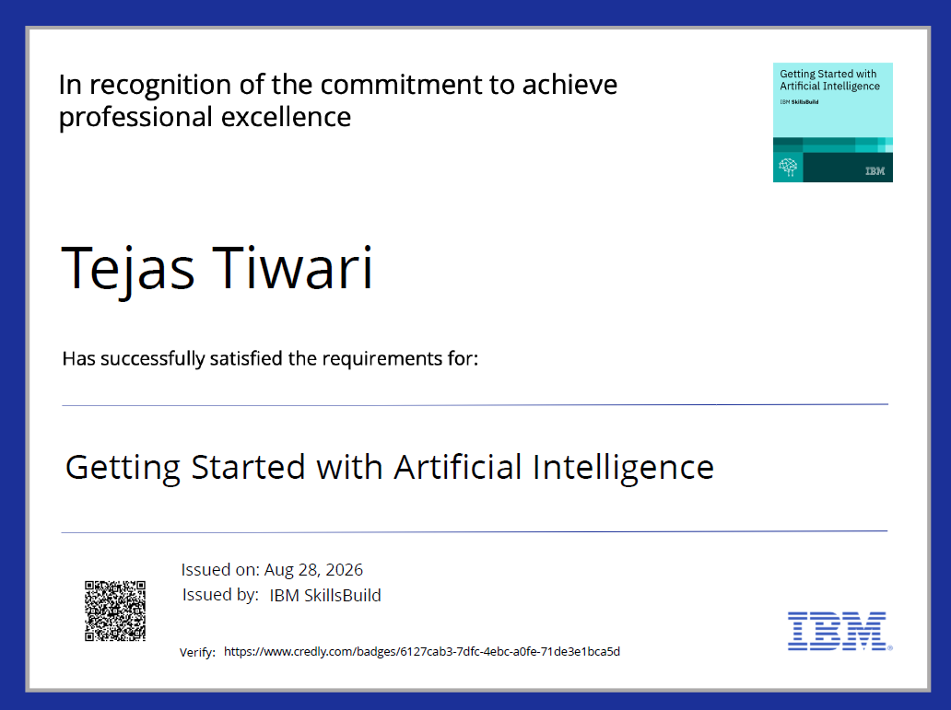
Certificates Earned:
Please add your credly certificate(Getting Started with Artificial Intelligence)

Slide 18
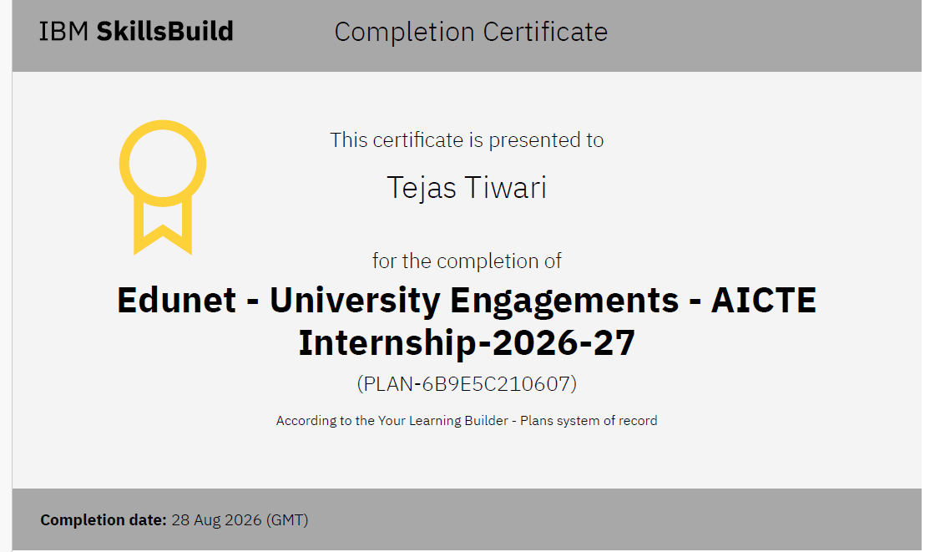
Certificates Earned:​
Add your IBM BOB Certificate

Slide 19


